Slide 1
United in Mission
CCUSA Workshop

Slide 2

Notes:
Prayer from Monday Week II:
Almighty Father, you have brought us to the light of a new day:
Keep us safe the whole day through from every sinful inclination.
May all our thoughts, words and actions aim at doing what is pleasing in your sight.
We ask this through our Lord, Jesus Christ, your Son,
Who lives and reigns with you and the Holy Spirit, God for ever and ever.
Amen.
This workshop will help participants develop a model for leadership in the workplace that is mission oriented and should provide a foundation in understanding oneself from a Catholic perspective that builds up holiness in individuals and a truly Catholic culture for the organization while embracing our unique gifts and differences.

Slide 3
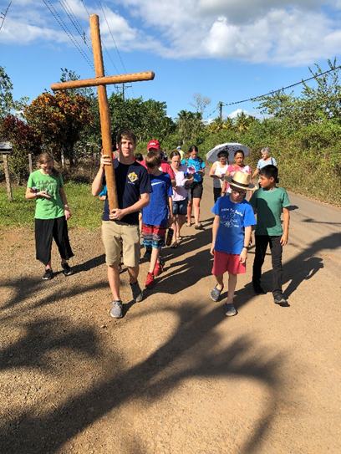
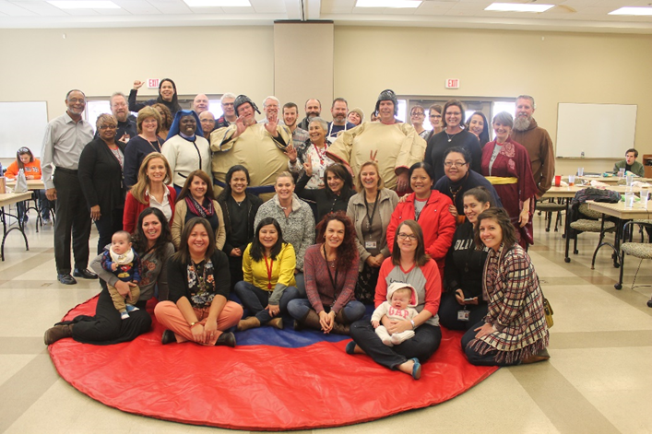
Leaders …
… need a place to go and others willing to follow
Notes:
Presentation Description
We can have many good leaders (managers, directors, even key volunteers) in an organization, but without a foundation in understanding oneself from a Catholic perspective, something will be missing that enhances culture and mission.
We’ll review the outline and content of the United in Mission initiative at CCEOK and hopefully give you insight into applying the framework into your organization. We will walk through the components of Leading the Spiritual Self, Leading the Outer Self and Leading Others adapted from a diagram in “Good Leaders, Good Shepherds”.
The framework is built around these three areas and covers:
How all (volunteers, clients and employees) have the same call to universal holiness. We are all the same at some level – image and likeness of God, human dignity, fallen sinners, restored and redeemed, called to a life of holiness.
Exploring our differences. We are all made different and relate to each other in different ways. We want to be aware of and celebrate our differences – all the different ingredients in a soup make for a very tasty meal – no one singled out for being better, but being unified in service and mission. We want to embrace our differences to build up the Body of Christ.
Using our similarities and our differences to build up leadership roles. How do we lead each other? How do we reach out in relationship to lead, serve, communicate, assist, delegate, support, encourage, challenge …. In order to fulfill our mission and have others recognize what makes us different. We all own the mission!
Catholic Charities University – United in Mission provides an understanding of the unique way our mission comes to life through customized dynamic course blocks delivered to employees and volunteers. Every teaching area is based on Catholic thought, specific to program needs and immediately applicable to the job function.

Slide 4
Learning Objectives
Experience the journey that CCEOK embarked on to prioritize Catholic culture - how we set goals, resourced them, engaged staff and developed content.
Build a common culture of ministry and management for staff who serve the human person in multifaceted ways, yet are called to be one in the mission.
Explore how culture and mission integrates with the individual and organization -how to apply content as the catalyst for positive but gradual change.

Slide 5
Outline
Intro
Journey of CCEOK Strategic Plan
Culture, Mission and Integration Overview
Building a Common Culture of Ministry and Management
Components of Leading Spiritual Self, Outer Self and Others
Q&A
Notes:
Began working for the Church in 1994 as Business Manager and Pastoral Associate for a large multi-cultural parish in New Hampshire. (Mass in 5 languages)
Ordained a Permanent Deacon in 2002 and earned a Master’s Degree in Theology.
Moved to Oklahoma in 2010 and started working at Catholic Charities of Eastern Oklahoma in 2011.
Have held several roles and now the Chief of Mission Integration – leading mission and culture as well as overseeing HR and Volunteer Engagement.

Slide 6
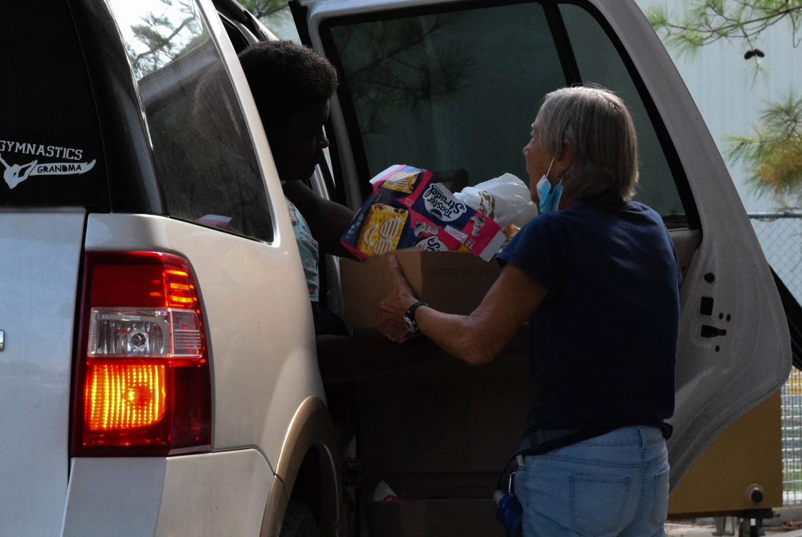
CCEOK Strategic Plan
2016-2018
Focused on 3 priorities:
Deepening our witness of solidarity
Deepening the engagement of those who serve
Deepening the reach of client care
Notes:
Quote from section on “The Strategic Direction”: Ultimately, the volunteers, employees and benefactors who are part of this community of faith will be called to go deeper in their relationship with each other, deeper in their respective leadership and deeper in their commitment to transform both society and themselves in alignment with Christ’s universal call to holiness.

Slide 7
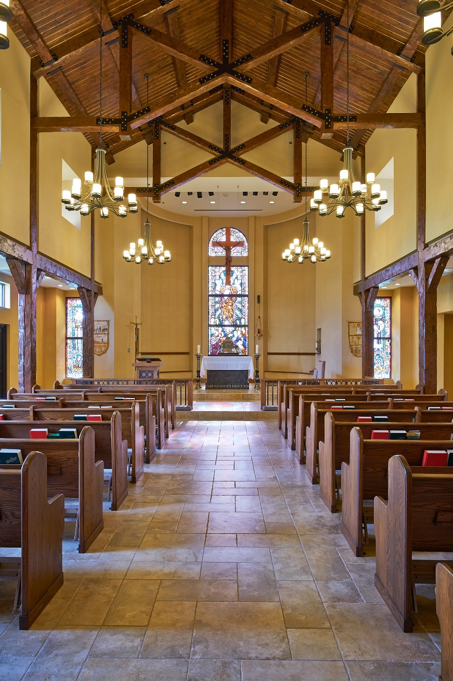
CCEOK Strategic Plan
2019-2021
Focused on 3 priorities:
Culture
Resources
Programs
Notes:
Culture:
Deepen our Catholic-based ministry by promoting Catholic Social Teachings to employees, volunteers and the board.
Strengthen our programs to be volunteer-centric in their approach by mentoring staff to achieve growth in volunteer leadership positions.
Create more opportunities for our volunteers to interface directly with people in need.
Formalized with the creation of the CMI position in 2020.
New hire/new volunteer cultural orientation
Onboarding includes intro to CST
Lunch and Learns
CCU retreats

Slide 8
Culture, Mission and Integration
Quick Overview
Culture: The way of life.
Our culture must center on Jesus, who is the Way, the Truth and the Life.
Mission: Putting culture into action.
Integration: Bringing about unity.
Notes:
Wikipedia says: Culture is an umbrella term which encompasses the social behavior and norms found in human societies [Organizations], as well as the knowledge, beliefs, arts, laws, customs, traditions, values, capabilities, and habits of the individuals in these groups. So we all contribute to the culture.
We acquire culture through the learning processes of enculturation and socialization, which is shown by the diversity of cultures across societies. Culture is the set of knowledge acquired over time.
Quote from: ASSESSMENT GUIDELINES FOR CULTURALLY RESPONSIVE ORGANIZATIONS OR PROGRAMS – CCUSA
“Culture shapes personal and group values and attitudes, including perceptions about what works and what doesn’t work, and what makes sense to a given community and what doesn’t. We all have a distinct cultural background that has helped define us as individuals and as members of our respective communities. Understanding a group’s culture helps agency professionals understand how members of that group view their environment and their role in it.”
Mission: Our purpose. Why we do what we do. Our vocation and calling. Ultimately to lead others to Christ through our words and actions. To be Christ’s merciful love to those who suffer. The hands and feet of Christ.
Integration occurs when separate people or things are brought together. Integration is defined as mixing things or people together that were formerly separated. The retreat we offer begins or continues this integration as we have people attend from all different programs.

Slide 9
Notes:
Red arrow box: Vision: To build a common culture of ministry and management for our employees and volunteers who serve the human person in many and multifaceted ways, yet, at their core, are called to be one in the mission of being Christ’s merciful love to those who suffer.
Bottom box: Catholic Charities University (CCU) will offer formation that aims to develop specific knowledge and skills (mind and body) as well as formation of the heart (soul).
CCU is designed to unite our staff (employees and volunteers) through common understanding and vision of service and foster an understanding of the culture and mission of Catholic Charities, identify and develop skills among staff, and provide practical tools to guide action and engagement.
Circles are not closed. Each is open (always room for growth) and each flows to the other.
CCU is offered to small groups of 10-12 people at a time. We go offsite for 3 days and 3 nights. Since the groups are a blend of employees and lead volunteers across different programs, the first night is spent getting to know each other. We enjoy dinner, have a few ice breakers (3 fun facts, this or that), then sip some wine or beer and sing some songs with Fr. John O’Neill.

Slide 10
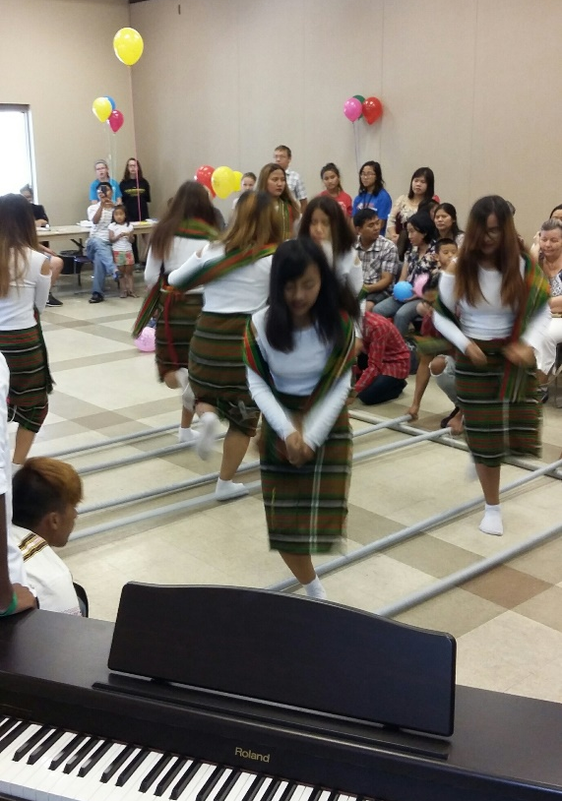
Building Culture: Ministry & Mgmnt.
Liturgy of the Hours (Morning Prayer)
Mass
Adoration
Onboarding New Staff includes Cultural Orientation
Lunch and Learns
Annual Retreats
CCU
Management Training
Notes:
Encouraged to “tithe” 10% of work week to prayer.
CO for staff – CST videos, CEO talk of history and culture of CC
Lunch and Learns – Formation of the Heart, Job specific at 6-12 per year
Annual Retreats – 3 days private
2X organization – formation and fun
CCU
Management Training – budgets, evaluations, coaching, payroll, timekeeping, policy and procedures, completing forms

Slide 11
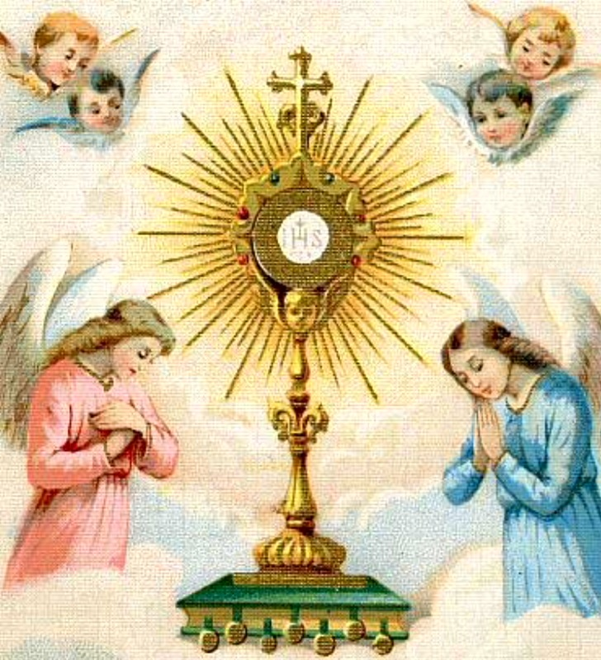
Components
Leading Spiritual Self
Kerygma – Forming Intentional Disciples
Deus Caritas Est (God Is Love)
Introduction to Virtue
Lives of the Saints
Becoming a Saint (Holiness)
Catholic Social Teaching
Notes:
Participants are encouraged to leave work at the office.
Each day of the retreat includes Mass and Morning and Evening prayer.
Since many are not familiar with turning pages in the Breviary, we have the prayers printed out.
Starting the first session with the Kerygma, sets the stage – the foundation of promoting Catholic culture in the workplace. It’s the proclamation of the Gospel message. I call it the “elevator speech” of Christianity. It’s about building relationships with others to bring them to encounter God’s grace and mercy through Jesus Christ. But we have to be properly disposed ourselves, prepared to be vessels of God’s grace and love, and have motives that are faithful and humble. We do this by leading our spiritual self. We need to be centered inwardly to be witnesses outwardly.
In the prologue of the Catechism of the Catholic Church it states, at every time and in every place, God draws close to man. He calls man to seek him, to know him, to love him with all his strength.
Participants discuss Michelangelo’s “The Creation of Adam” and discuss how they can close the gap between themselves, God and others.
Each person receives a plaque with a simple Kerygma prayer: Jesus Christ loves you; he gave his life to save you; and now he is living at your side every day to enlighten, strengthen and free you.
Discussion questions and scripture reflections.

Slide 12
Components
Leading Spiritual Self
Kerygma – Forming Intentional Disciples
Deus Caritas Est
Introduction to Virtue
Lives of the Saints
Becoming a Saint (Holiness)
Catholic Social Teaching
Notes:
Participants are asked to read God Is Love prior to the retreat.
This session has been led by a priest and has varied each time. The theme of God’s love is explored, how God loves us unconditionally and our response to God’s love by our love for others.
Parable of the Good Samaritan
Part II – the blueprint for CC
Para. 28b – “There is no ordering of the State so just that it can eliminate the need for a service of love. There will always be suffering which cries out for consolation and help. There will always be loneliness. There will always be situations of material need where help in the form of concrete love of neighbor is indispensable.”
Para. 31a – must first be professionally competent – formation of the heart – understanding humanity – purpose of the retreat.
Para. 33 – we should be guided by the faith that works through love … they must be moved by Christ’s love.
The love of Christ compels us.

Slide 13
Components
Leading Spiritual Self
Kerygma – Forming Intentional Disciples
Deus Caritas Est
Introduction to Virtue
Lives of the Saints
Becoming a Saint (Holiness)
Catholic Social Teaching
Notes:
The goal of a virtuous life is to become like God.
A virtue is an habitual and firm disposition to do the good.
CCC 1804 – Human virtues are firm attitudes, stable dispositions, habitual perfections of intellect and will that govern our actions, order our passions, and guide our conduct according to reason and faith.
Provide list of many virtues and discuss how a vice may be a deficiency or excess of a virtue.
For example: the virtue of humility is linked to the vice of deficiency (Self-deprecating) and excess (Boastful)
Prayer, Fasting and Almsgiving keeps us rooted in a virtuous life.

Slide 14
Components
Leading Spiritual Self
Kerygma – Forming Intentional Disciples
Deus Caritas Est
Introduction to Virtue
Lives of the Saints
Becoming a Saint (Holiness)
Catholic Social Teaching
Notes:
We have had several different presenters and each has highlighted the lives of the saints that have been inspirational to them.
Key point – saints were just like us. What can we learn from their lives? We can see the messiness of their lives, their struggles and how they overcame. How can we relate to them? Saints are models for us.
In their human life, saints were weak, fallen and wounded. But they overcame to live lives of virtue, holiness, immersed in Christ with their hearts on fire with His love.
Even St. Augustine said, “I will do your will, but not just yet.”
Saints highlighted in this session have been:
St. Teresa of Avilla
St. Theresa of Calcutta
Bl. Carlo Acutis
St. Elizabeth of Hungary
St. Therese of Liseux

Slide 15
Components
Leading Spiritual Self
Kerygma – Forming Intentional Disciples
Deus Caritas Est
Introduction to Virtue
Lives of the Saints
Becoming a Saint (Holiness)
Catholic Social Teaching
Notes:
After learning about the lives of some saints, we give a session on how to live a life of holiness.
CCC 2013 – Be perfect as your heavenly Father is perfect.
Introduction to the Devout Life by St. Francis de Sales
Give them lots of questions to discuss and things to reflect on.

Slide 16
Components
Leading Spiritual Self
Kerygma – Forming Intentional Disciples
Deus Caritas Est
Introduction to Virtue
Lives of the Saints
Becoming a Saint (Holiness)
Catholic Social Teaching
Notes:
In one evaluation at the conclusion of the retreat, one participant wrote of the wonderful experience, but also said, the sessions were a mile wide and an inch deep. We could easily make a 3 day retreat out of any of these topics, but the intent is to give some exposure to things they may not have thought of. Or at least to encourage them to delve further on their own.
And so it is with CST.
High level introduction to the principles of Human Dignity, Solidarity and Subsidiarity.
Help participants to recognize and live these principles through their work.

Slide 17
Notes:
This is one of the handouts used for the discussion questions.

Slide 18
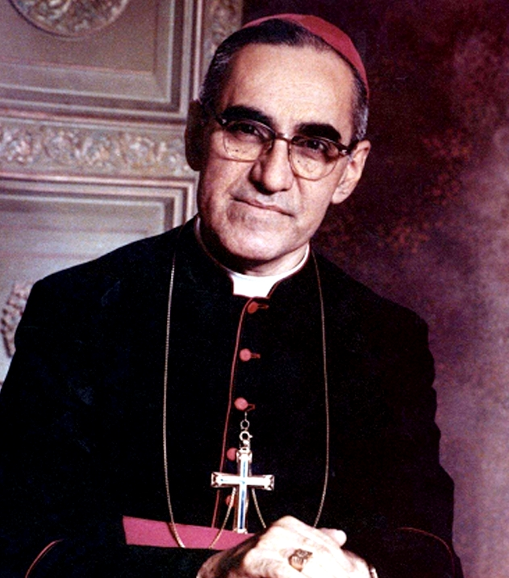
Components
Leading Outer Self
DiSC Part I & II
Gifts of the Holy Spirit
Movie: Romero
Servant Leadership
Leading a Balanced Life
Wheel of Mission
Notes:
We have used the DiSC assessment tool for a number of years. A tool for understanding yourself and others better. Myers Briggs or other tools could accomplish the same thing.
It is important to know our own limitations, what we can do to overcome them, how we present ourselves to others and finally how we relate to others who have a different profile.
They get an understanding of their workplace priorities and preferences.
Dominant/Direct
Influencer/Enthusiastic
Steady/Service
Conscientious/Cautious

Slide 19
Components
Leading Outer Self
DiSC Part I & II
Gifts of the Holy Spirit
Movie: Romero
Servant Leadership
Leading a Balanced Life
Wheel of Mission
Notes:
We probably all know the 7 gifts of the Holy Spirit:
Wisdom
Understanding
Counsel
Fortitude
Knowledge
Piety
Fear of the Lord
But honestly this has been the session most difficult to have a great impact. (We have had 3 different presenters) I think we could look at St. Thomas Aquinas’ interpretation of these gifts, but need to help participants recognize the gifts in themselves.
The gifts of the Holy Spirit help us on the way of perfection. We tend to not want to toot our own horn. But we can life as a witness by applying these gifts.

Slide 20
Components
Leading Outer Self
DiSC Part I & II
Gifts of the Holy Spirit
Movie: Romero
Servant Leadership
Leading a Balanced Life
Wheel of Mission
Notes:
I chose the movie Romero because he exemplifies the progression of leading the spiritual self, outer self and others. It can be very disturbing for some to watch so we have a break following the movie before coming back to discuss. After the discussion, emotions have been high so they have another break. Then Mass is celebrated.
From the Oscar Romero Prayer:
We accomplish in our lifetime only a tiny fraction of the magnificent enterprise that is God’s work. We plant the seeds that one day will grow. We water seeds already planted, knowing they hold future promise. We lay foundations that will need further development.

Slide 21
Components
Leading Outer Self
DiSC Part I & II
Gifts of the Holy Spirit
Movie: Romero
Servant Leadership
Leading a Balanced Life
Wheel of Mission
Notes:
There are probably thousands of books on the subject of leadership or becoming a leader, but the one preeminent book on servant leadership is the Bible.
Our presenter uses the Bible as THE book of leadership.
Discuss attributes of a servant leader. Selflessness and humility are key.
The great leader is first seen as a servant. The first shall be last and the last shall be first.
Following Jesus … leading others to Jesus – Baptismal call
Leading a balanced life
We use the story of Martha and Mary in the Gospel of Luke. We may be inclined as servants in the Church to be like Martha, but we all need times when we are like Mary. This is a conversational session discussing the challenges and joys we have in our work and recognizing the times when we need to sit at the feet of Jesus. We discuss how stress and pressure can lead to burnout, but also recognize the sweet spot when we are at our optimal performance.
Cats in the Cradle
Accountability partners

Slide 23
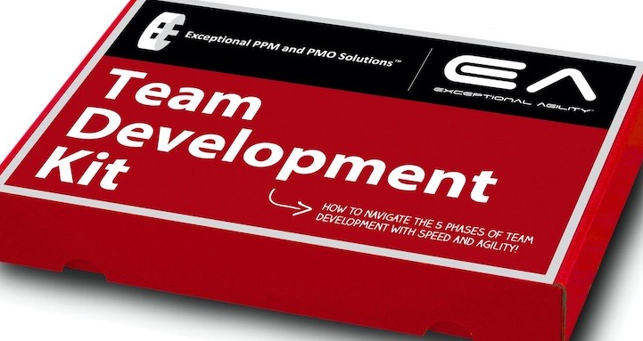
Components
Leading Others
Christian Leadership and Hospitality
Team Development
Building Trust in the Team
Crucial Conversations
Welfare, Charity
and Mission
Notes:
Does Christian leadership and hospitality define the person who takes charge to set up coffee and donuts after Mass? Maybe so, but it goes much further. Does Mt. 25 resonate with you? “When I was a stranger, you welcomed me.” Hospitality means being aware of someone’s need without them asking for help. We discuss how we can do this with co-workers, clients, guests or any person coming to the door?
Being a hospitable host in a Christian way. It’s a moral obligation – the outworking of the Holy Spirit using us. It’s a sacred duty.
Monty Hall – Door 1, 2 or 3? We say no wrong door.
Team Development
Gives an overview of the stages a team or program go through. Forming, Storming, Norming, Performing, Transforming
Puts into perspective what many have experienced.
Identifies leaders role in setting expectations and modeling behavior.
Highlights our interactions and relationships with others.
Building Trust in the Team
This is a session that gives a lot of best practices as someone who leads others.
Inspect what you expect.
Divine Mercy image – Jesus, I trust in you.
Takes patience, vulnerability, humility, commitment, courage, accountability, transparency
4 scripture passages used for clarity.
Crucial Conversations
Participants are asked to read the book prior to the retreat.
Discussion on people’s tendencies for flight or fight – here called silence or violence.
Explores principles and skills. Role playing.
Starting with heart
Find the mutual purpose
Shared pool of meaning
Respect for each other
Determine what to accomplish
Do what is best for yourself, the other person and the relationship.
Welfare, Charity and Mission
Article subtitled “Postures in the Helping Relationship”
Read and discuss the article.

Slide 24
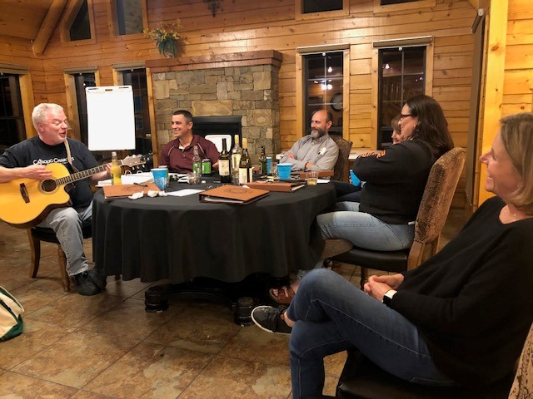
Wrap Up
Evaluations
Blessing/Commissioning
Certificates
Follow up Mtgs.
Accountability partners
Offering a version of
CCU to parishes

