Slide 1
Engaging the Diaconate
How Dallas Equips Deacons to Integrate Faith and Service
Rev. Emmett Hall, JCL
Lacy de la Garza, M.Psy

Slide 2
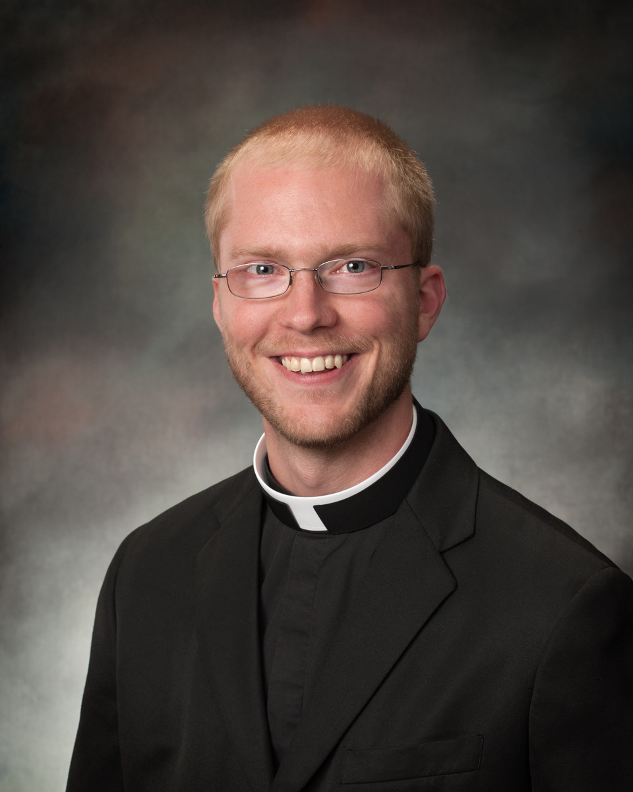
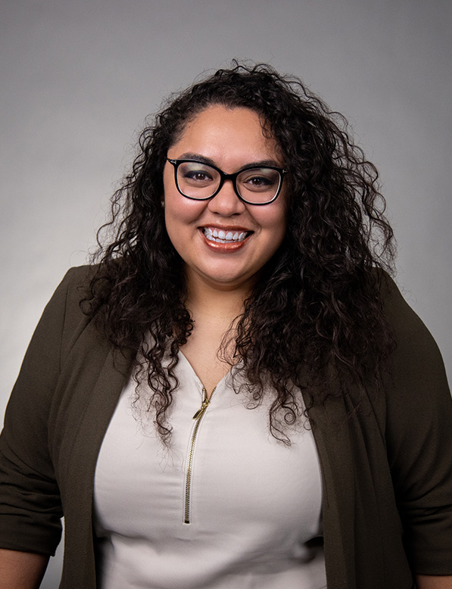
Introductions
Rev. Emmett Hall, JCL
ehall@cathdal.org
214-379-2859
Lacy de la Garza, M.Psy
ldelagarza@ccdallas.org
469-801-8134

Slide 3
Overview
Understanding the Diaconate
Why Deacons?
Natural pairing of Diaconate and CCD
Case Study: Dallas
  Overview of Dallas Diaconate
  Necessity of CEUs
  Advent of our program
Questions
Notes:
Why Diaconate? 6
Why Deacons? 6
Natural pairing of Diaconate and CCD 3
Case Study: Dallas 30
Overview of Dallas Diaconate
Necessity of CEUs
UDMC / Covid changes
Advent of our programa
Tension of zoom / in-person accessibility

Slide 4
Diaconate - Definitions
At a lower level of the hierarchy are deacons, upon whom hands are imposed "not unto the priesthood, but unto a ministry of service."For strengthened by sacramental grace, in communion with the bishop and his group of priests they serve in the diaconate of the liturgy, of the word, and of charity to the people of God. It is the duty of the deacon, according as it shall have been assigned to him by competent authority, to administer baptism solemnly, to be custodian and dispenser of the Eucharist, to assist at and bless marriages in the name of the Church, to bring Viaticum to the dying, to read the Sacred Scripture to the faithful, to instruct and exhort the people, to preside over the worship and prayer of the faithful, to administer sacramentals, to officiate at funeral and burial services. Dedicated to duties of charity and of administration, let deacons be mindful of the admonition of Blessed Polycarp: "Be merciful, diligent, walking according to the truth of the Lord, who became the servant of all.”
― Lumen Gentium n. 29
Notes:
Fr. Emmett
Q: Should we bold any phrases within this definition?

Slide 5
Diaconate - Definitions
For there are men who actually carry out the functions of the deacon's office, either preaching the word of God as catechists, or presiding over scattered Christian communities in the name of the pastor and the bishop, or practicing charity in social or relief work. It is only right to strengthen them by the imposition of hands which has come down from the Apostles, and to bind them more closely to the altar, that they may carry out their ministry more effectively because of the sacramental grace of the diaconate.
― Ad Gentes n. 16
Notes:
Fr. Emmett
Q: bold?

Slide 6
Diaconate - Definitions
Deacons share in Christ's mission and grace in a special way. The sacrament of Holy Orders marks them with an imprint ("character") which cannot be removed and which configures them to Christ, who made himself the "deacon" or servant of all. Among other tasks, it is the task of deacons to assist the bishop and priests in the celebration of the divine mysteries, above all the Eucharist, in the distribution of Holy Communion, in assisting at and blessing marriages, in the proclamation of the Gospel and preaching, in presiding over funerals, and in dedicating themselves to the various ministries of charity.
― Catechism of the Catholic Church n. 1570
Notes:
Fr. Emmett
Q: bold?

Slide 7
Diaconate - Definitions
By divine institution, some of the Christian faithful are marked with an indelible character and constituted as sacred ministers by the sacrament of holy orders. They are thus consecrated and deputed so that, each according to his own grade, they may serve the People of God by a new and specific title.
― Code of Canon Law, can. 1008
Those who are constituted in the order of the episcopate or the presbyterate receive the mission and capacity to act in the person of Christ the Head, whereas deacons are empowered to serve the People of God in the ministries of the liturgy, the word and charity.
― Code of Canon Law, can. 1009 §3
Notes:
Fr. Emmett

Slide 8
Diaconate - Diakonia
Modern Understanding: diakonia as lowly or humble service
Ancient Usages:
  Service at sacrificial meals
  High-ranking servant: personal attendant of a nobleman
  Emissary: one who acts on behalf of another (especially within a religious context)
Early Christian Usages:
  Jesus’ mission: giving his life as a ransom for many (Mk. 10:45)
  Apostolic Ministry (Acts 1:17, 24; Acts 6)
  The ministry of St. Paul & his collaborators (e.g. Rm. 15:25; 1 Cor. 3:5; Eph. 6:21)
Notes:
Fr. Emmett

Slide 9
Diaconate - Models of the Diaconate
Icon of Christ the Servant
Deacon as Intermediary
Deacon as Levite
Notes:
Fr. Emmett
Q: do we want to track down images?

Slide 10
Why Deacons?
By ordination, the deacon, who sacramentalizes the Church’s service, is to exercise the Church’s diakonia. Therefore, “the diaconal ministries, distinguished above, are not to be separated; the deacon is ordained for them all, and no one should be ordained who is not prepared to undertake each in some way.” “However, even if this inherent ministerial service is one and the same in every case, nevertheless, the concrete ways of carrying it out are diverse; these must be suggested, in each case, by the different pastoral situations of the single churches.” A deacon may also have greater abilities in one aspect of ministry; and, therefore, his service may be marked by one of them more than by the others. Fundamentally, however, there is an intrinsic unity in a deacon’s ministry. In preaching the word, he is involved in every kind of missionary outreach. In sanctifying God’s People through the Liturgy, he infuses and elevates people with new meaning and with a Christian worldview. In bringing Christ’s Reign into every stratum of society, the deacon develops a Christian conscience among all people of good will, motivating their service and commitment to the sanctity of human life.
― National Directory for the Formation, Ministry, and Life of Permanent Deacons in the United States of America, n. 41
Notes:
Fr. Emmett
Education requirements
Pandemic
Natural fit for us

Slide 11
Our program – Education of CCD services
Education of CCD services
  Modification of our “fluency model”
    What we do
    Why we do it
    How to get involved
  What CCD does
  Why we do it
  How they as deacons can be involved themselves
  How they as deacons can encourage / facilitate their parish involvement
Notes:
Lacy

Slide 12
Our program – Certification
Intended to offer a “CCD Certification” component to this process
  Will continue to pursue this as we restart the program
Must receive 12-16 CEUs to complete
  Requirement of 12 CEUs per year
Would then be deemed “Certified” in CCD missions and services from a parish perspective
  An element of engagement that a pastor or a parish may be looking for
Would then be called upon by Charities to give counsel as needed, and write for us as needed
  Undefined yet necessary
  Time for Giving
  Homily helps
  Prayer Intentions
  Pastoral presence
Notes:
Lacy

Slide 13
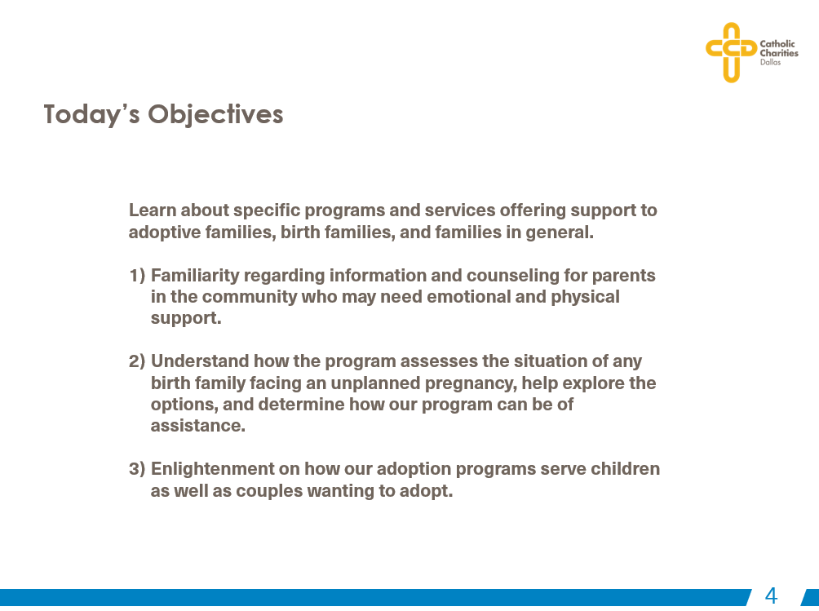
Our program – sample objectives
Notes:
Lacy

Slide 14
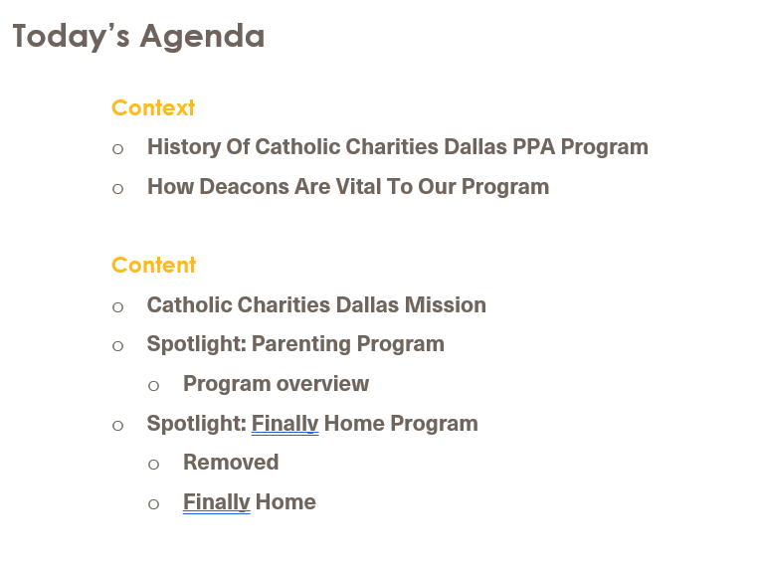
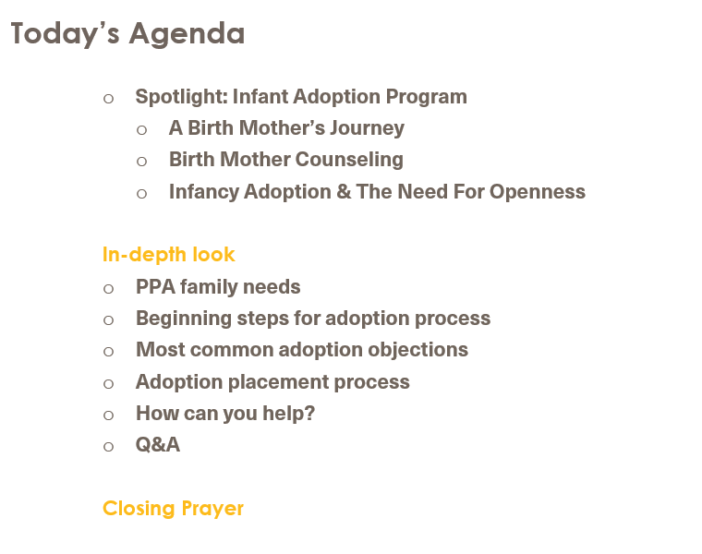
Our program – sample agenda
Notes:
Lacy

Slide 15
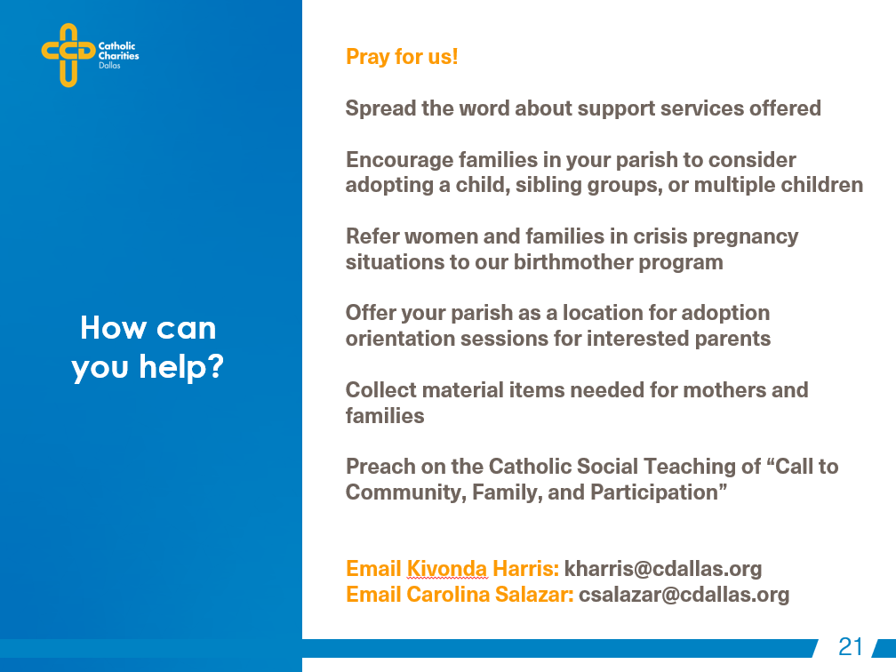
Our program – sample ways to get involved
Notes:
Lacy

Slide 16
Our program - Structure
Structure
  1 webinar every 6-8 weeks
  Completed webinars ranged from 1-2 hours long (with CEUs given accordingly)
  5 programs deemed “required” v. 7 programs deemed “elective”
  Timing
    English: Sunday afternoons
    Spanish: Wednesday early evenings
Notes:
Lacy

Slide 17
Our program - Structure
Required
  CCD Overview with Catholic Social Teaching
  Immigration Legal Services
  Hunger Services
  Pregnancy, Parenting & Adoption
  Volunteer Services
Elective
  Homelessness & Housing
  Educational Services
  Senior Services
  Financial Stability & Career Services
  Refugee Resettlement Services
  Children’s Services
  Disaster Relief & Preparedness Services
Notes:
Lacy

Slide 18
Results
Completion Rates
Attendees
Considerations
Successes
Notes:
Lacy
CCD Certification idea
Recognition of deacons in a special way by parish / diaconate program / CCD
Reducing diocesan redundancies

Slide 19
Results – considerations
Making the certification more appealing
Deacon’s wives
Advertising / marketing / personal invitations
Factor in more vibrantly adult learning styles
Notes:
Fr. Emmett
Deacon’s wives
Making the certification more appealing
Advertising / marketing / personal invitations?
Factor in more vibrantly adult learning styles
- Send back to Lacy for a quick explanation
-Larger focus, or smaller focus? Is this something that’s worth trying to do as a big block of things, or focus on deeper dives one-off things?

Slide 20
Results – successes
More common understanding of CCD programs
Deeper relationship for mutual benefit of parish & CCD
Deacons fulfilling CEU requirement
Stronger foundation for future growth
Notes:
Lacy

Slide 21
Results – pitfalls to avoid
Variations of deacon involvement
Geographical disparity
Reducing redundant parish and social ministries
Notes:
Lacy
Geographical disparity in application of information (and readiness to implement)
Reducing redundancies
Eliminating redundancies of what parishes do v. what CCD does already
Variations of deacon involvement
Varying levels of deacon involvement
Parish to parish
Very involved to less involved
Urban v. suburban v. rural social service need disparity
Visible v. invisible need

Slide 22
Questions?
Notes:
both

Slide 23
Contact information
Rev. Emmett Hall, JCL
ehall@cathdal.org
214-379-2859
Lacy de la Garza, M.Psy
ldelagarza@ccdallas.org
469-801-8134

